Slide 1
ASE 120 K
On aerodynamic characteristics of an American football

Slide 2
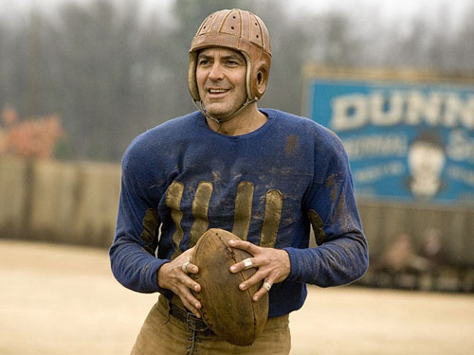
Introduction
Football has been part of American Sports since the latter of the 1800’s
Forward pass made legal in 1906
Boyd Epley in 1969

Slide 3
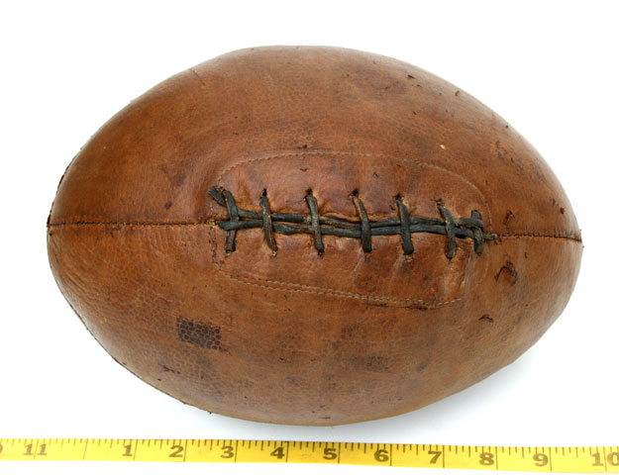
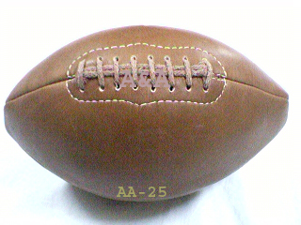
The Football
First footballs were rugby balls
Ball specifications were added in 1912
Design changes in the 1920’s created the football we recognize today

Slide 4
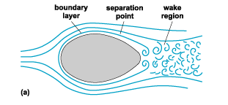
Drag on a football
Drag is an important aspect of football flight
What effects do football velocity and rotation rate have on drag?

Slide 5
Apparatus
Equipment
Rawlings Official NCAA Supreme Footballs
Football pump
Metal rods
Multi-speed drill
Tachometer
Instruments for Measurements
Smoke Wire
  Flow visualization
Pitot-Static Tube
  Wake profile measurement

Slide 6
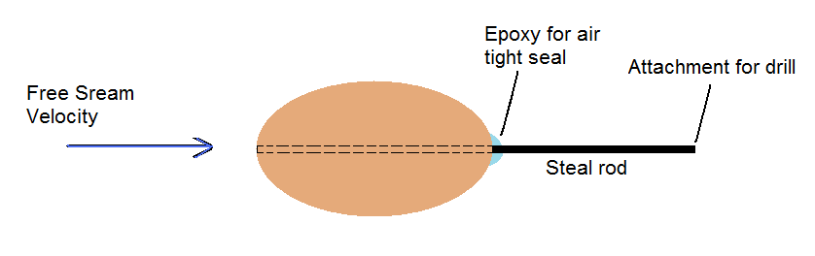
Experimental Setup
Stainless Steel Rod inserted through one end of the football
Back end of rod will be attached to a drill for rotation
Epoxy glue will be applied around edges of the rod at point of insertion:
  Torque structure
  Air tight seal
Re-inflate ball
Figure 5: Experimental setup

Slide 7

Procedure flow visualization

Slide 8
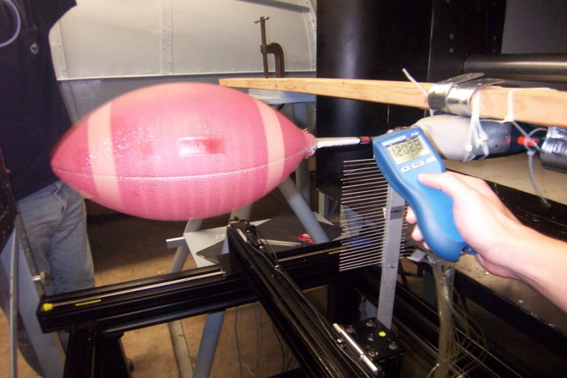
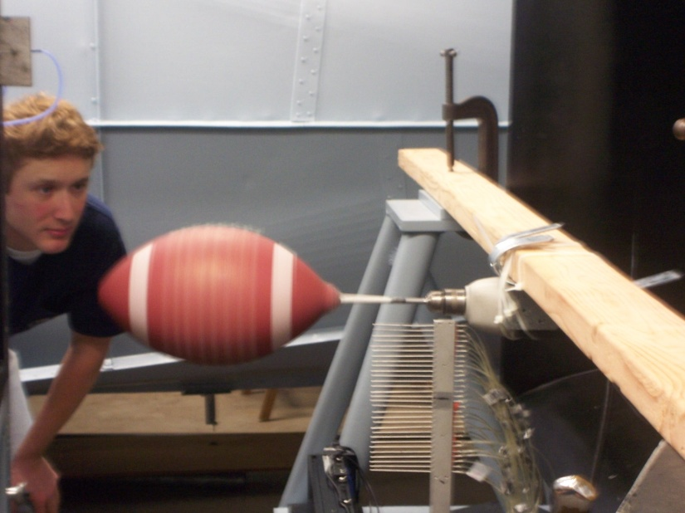
Procedure: Wake Profile Analysis
Main goal: Find relationship between drag acting on football and rotation speed
Typical Football Speed 40-60 mph
  Test Speed 50 ft/s (34 mph) to 70 ft/s (47.7 mph)
Measurements taken at 800, 1000, and 1200 rpm
Velocity profile found

Slide 9
Results
1) Flow visualization
2) Wake profile measurements

Slide 10
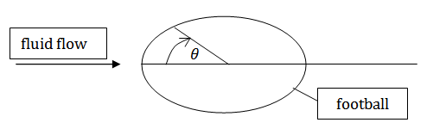
Flow visualization
- State of the flow (turbulent or laminar)
Flow separation point
    Orientation:
Angle of flow direction after separation point

Slide 11
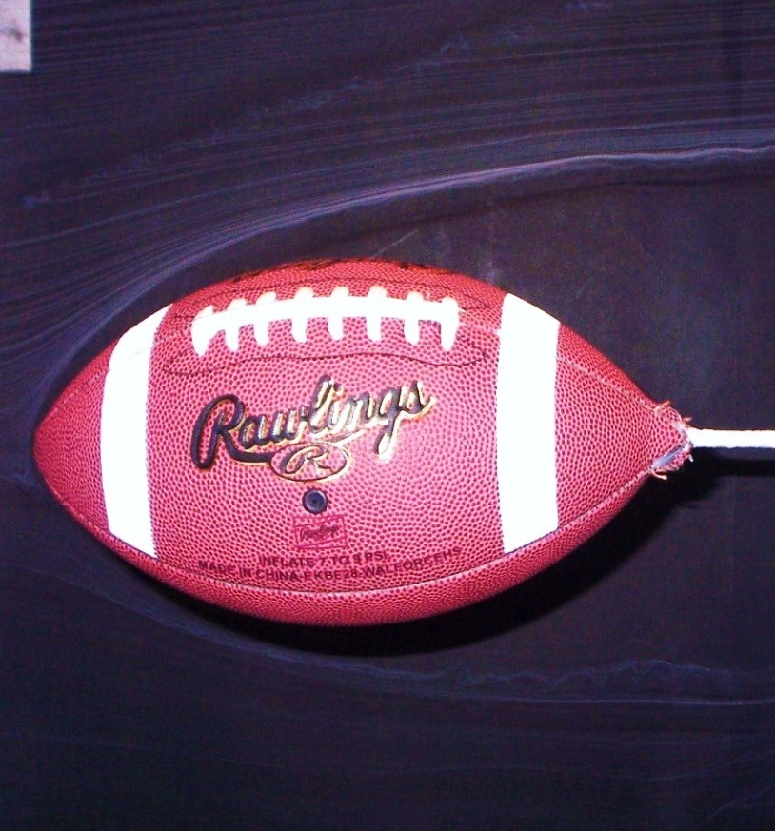
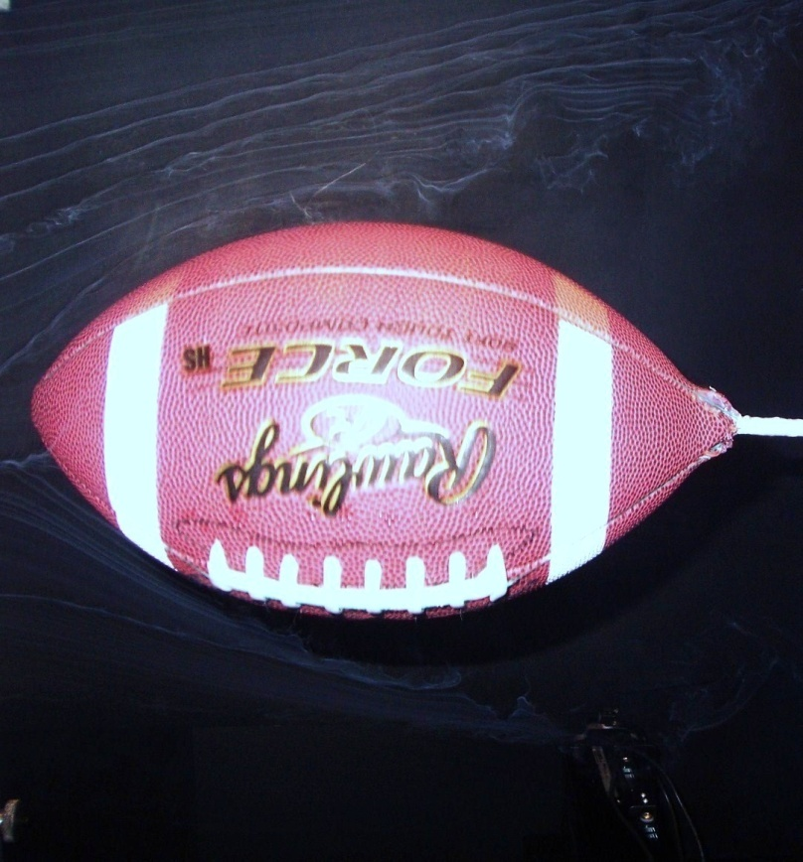
Separation Point
θ ≈ 50 °
θ ≈ 100 °
(a)
(b)
Smoke flow visualization for (a) non rotation and (b) rotation of 1200 rpms

Slide 12
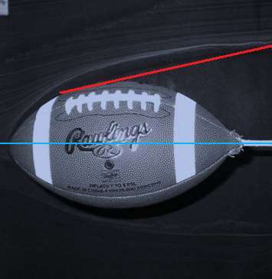
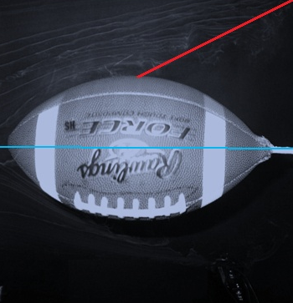
Angle of flow direction
β ≈ 15°
β ≈ 30°
(a)
(b)
Angle at which the flow separates away from ball for (a) non-rotation (b) rotation

Slide 13
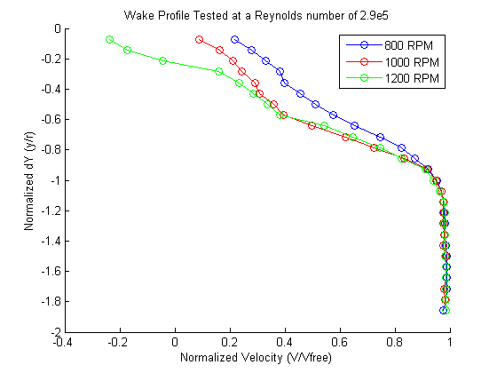
Wake Profile

Slide 14
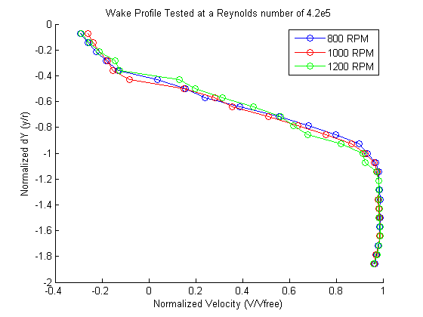

Slide 15
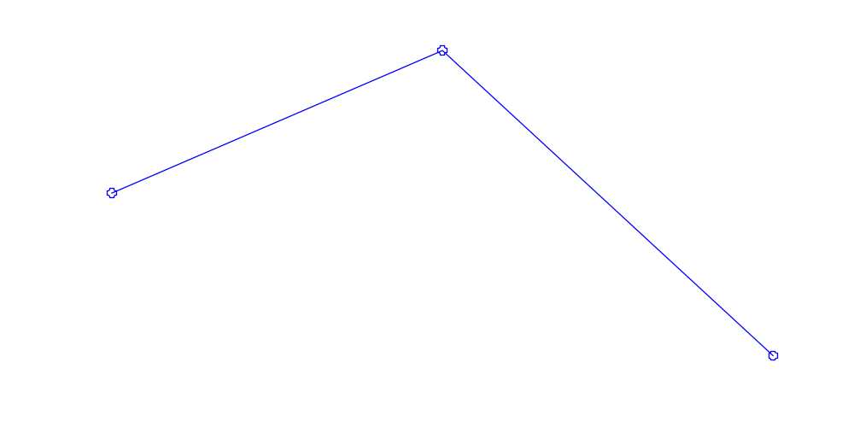
Drag
Re ~ 290,000 (~50 ft/s)

Slide 16
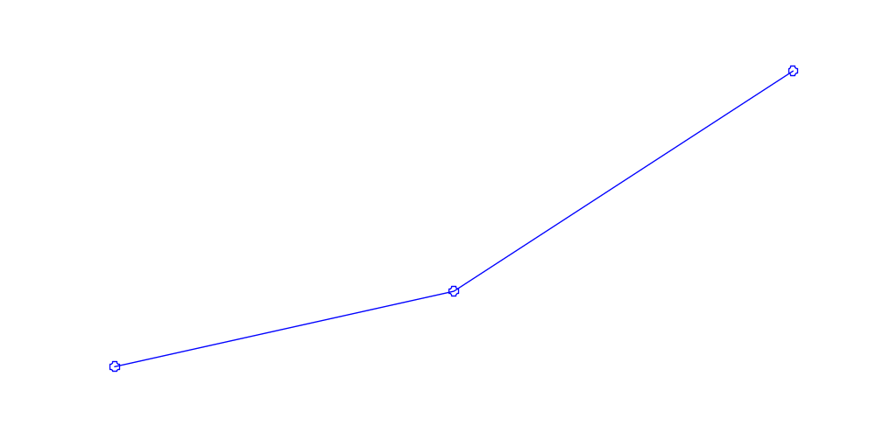
Re ~ 420,000 (~70 ft/s)

Slide 17
Challenges with Setup
The two main difficulties that our group faced were:
Mounting the football perfectly on the rod
Reducing the wobble after rotating the football

Slide 18
Conclusion
Higher RPM, higher drag
Higher Reynold’s number, higher drag
More rotation means wasted energy
What can scouts take from this?

Slide 19
Sources
Rae, W., Streit, R. 2002, Wind-tunnel measurements of the aerodynamic loaads on an American football. Sports Engineering (InternationalSports Engineering Association), Vol 4 Issue 3. p165.
Rae, W. 2003, Flight dynamics of an American football in a forward pass. Sports Engineering (International Sports Engineering Association), Vol 6 Issue 3. p149.
Watts, R., Moore, G. 2003 The drag force on an American football. American Journal of Physics, Vol 71 Issue 8. p791.

